Slide 1

Multivariate Regression Approach to Predict House Prices: with data of house Prices of Ames, Iowa
Multivariate Linear Regression

Slide 2

contents
Introduction
Exploratory Data Analysis
Handling Missing Values
Working Categorical Data
Feature Selection
Handling Outliers
Scaling Numerical Data
Model Training
Linear Regression
Decision Tree Regressor
Lasso
Ridge
Elastic-Net
Summarize using K-fold
Business Visualization:
Hyperparameter – Validation Curve
Bias and Variance – Learning curve

Slide 3
Introduction & Project Context
Introduction and Business Problem
House buyers while narrating about their dream houses, they may mention and consider their requirements at high level in terms of number of bed rooms, number of floors, built up area, with pool, locality, etc., but may not know many other influencing factors which would determine the house price, and influence price negotiations.
We have real estate transactions’ information and dataset with 80+ variables to analyse and to learn what all relevant factors/ variables would influence housing prices.
Data Set Size
1460 records & 81 variables

Slide 4

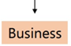
Approach to Build the ML Model
Data Preparation
Transforming the features in the data to be model ready
Data Manipulation
Model Training
Machine Learning Algorithms are applied based on the business objectives
Supervised learning techniques
Model Optimization
Create the best possible model that is more accurate
Feature Selection
Scaling
Model Validation
Parametric and Non-parametric techniques
Accuracy is tested
K-Fold Cross Validation
Validation Curve
Learning Curve
Compare the results from different model
Verify R2 and RSME
Feature Reduction
Deployment Ready

Slide 5
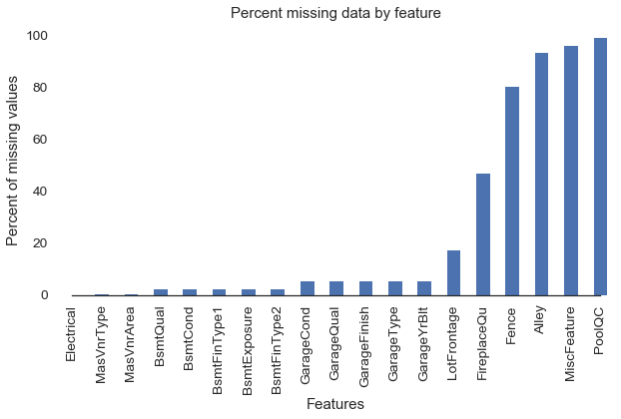
Exploratory Data Analysis Percent Missing values
Predictors with more than 40% missing were dropped and others were treated for random missing

Slide 6
Exploratory Data Analysis Missing value treatment
Some of the non-numeric predictors are stored as numbers; convert them into strings
Some of predictors with less than 15% missing values replaced by mean in numerical and mode in categorical
Analysis for missing value done whether it missing at random or is there some other reason
Examples:
GarageType , GarageYrBlt, GarageFinish, GarageCond, GarageQual all have 81 missing values.
But GarageCars and GarageArea have all the value (no null values). These two variables have ZERO for all those 81 records.
Treatment:
For GarageType ,GarageFinish, GarageCond, GarageQual - replaced ‘NA’ with 'None‘.
GarageYrBlt if is not available for a particular home, then all values are ‘NA’ or ‘Zero’. We treated by adding another column with the name- GarageIf, and given 1 or 0 corresponding to GarageYrBlt.

Slide 7
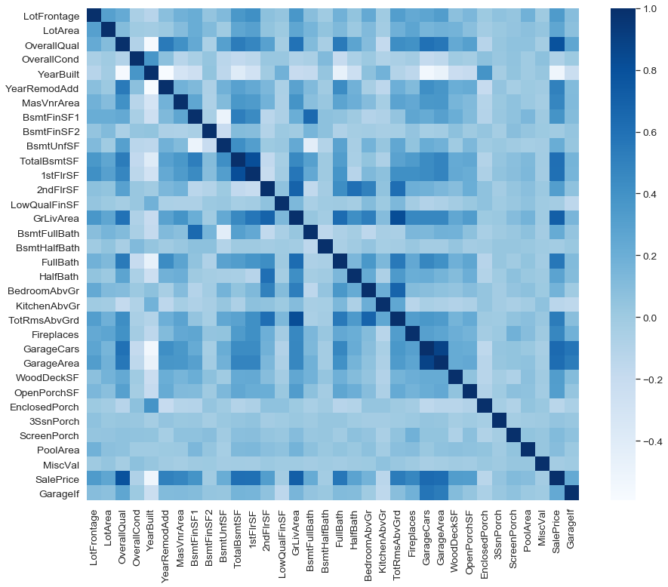
Exploratory Data Analysis Feature Selection: Correlation Matrix

Slide 8
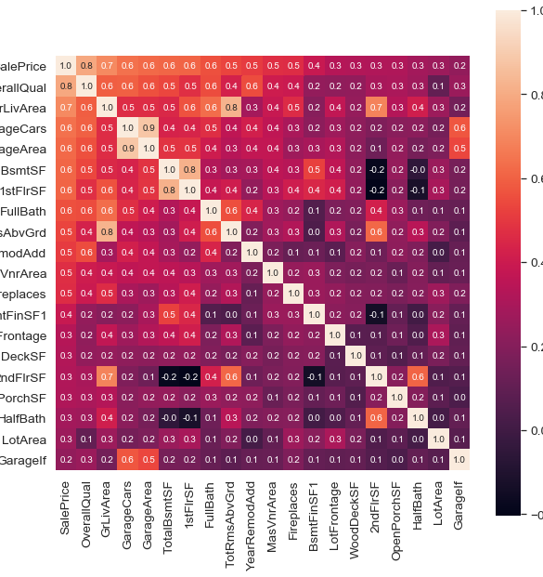
Exploratory Data Analysis Feature Selection: Heat-Map
There is 83% correlation between TotRmsAbvGrd and GrLivArea and 89% correlation between GarageCars and GarageArea
Similarly, many other features such as BsmtUnfSF, FullBath have good correlation with other independent feature.
It also becomes clear the multicollinearity is an issue.
For example: the correlation between GarageCars and GarageArea is very high (0.89), and both have similar (high) correlations with SalePrice.
The other 6 variables with a correlation higher than 0.5 with SalePrice are: -
TotalBsmtSF: Total square feet of basement area
1stFlrSF: First Floor square feet
FullBath: Full bathrooms above grade
TotRmsAbvGrd: Total rooms above grade (does not include bathrooms)
YearBuilt: Original construction date
YearRemodAdd: Remodel date (same as construction date if no remodeling or additions)
These features can be removed: FullBath, YearRemodAdd, 2ndfloorsf, 1stFlrSF Totalroomabgrd, GarageCars

Slide 9
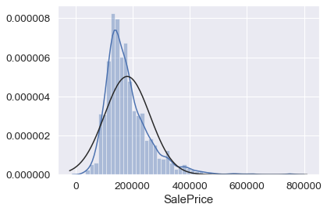
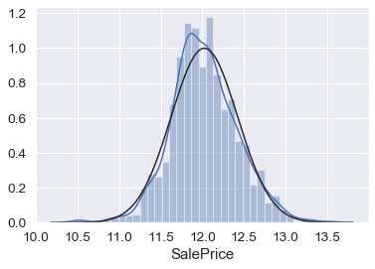
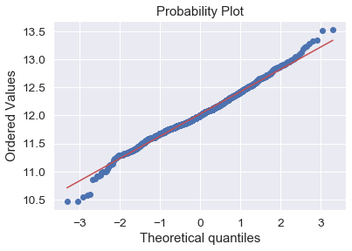
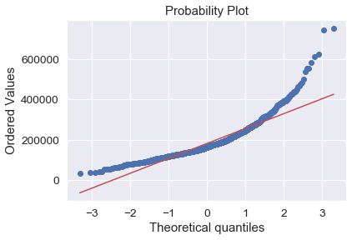
Exploratory Data Analysis Feature Selection: Treatment of skewness in Sale price
Treated skewness by taking log(1+x) of sales price
from scipy.stats import norm
from scipy import stats
sns.distplot(all_features['SalePrice'], fit=norm);
fig = plt.figure()
res = stats.probplot(all_features['SalePrice'], plot=plt)
sns.distplot(trainData['SalePrice'], fit=norm);
fig = plt.figure()
res = stats.probplot(all_features['SalePrice'], plot=plt)

Slide 10
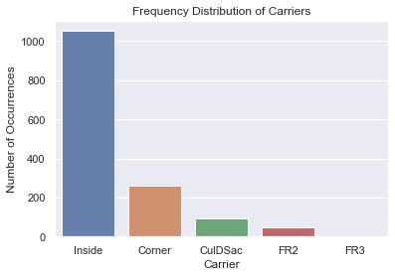
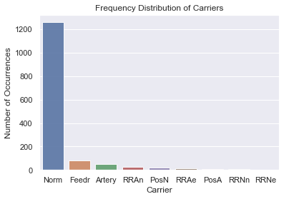
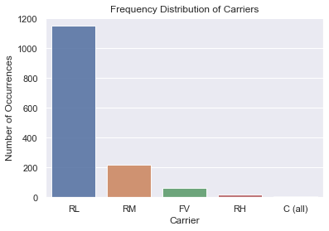
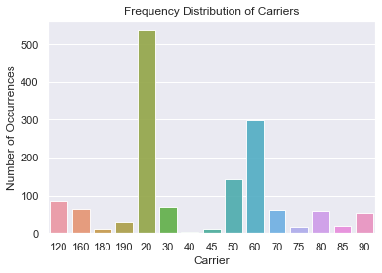
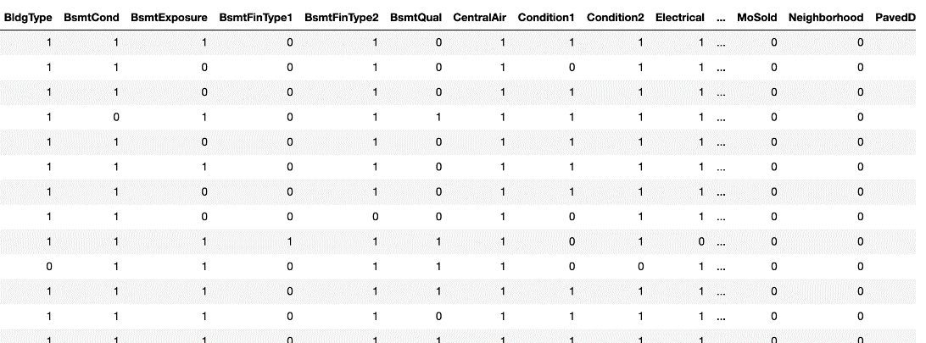
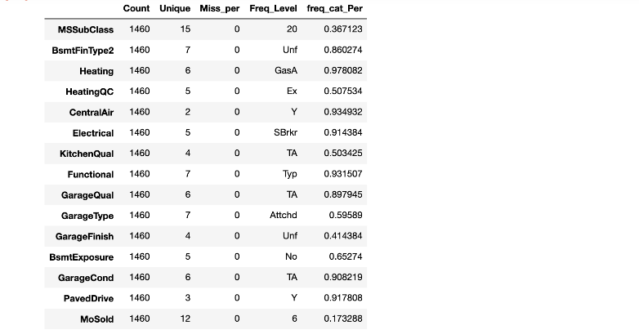
Exploratory Data Analysis Feature Selection: Custom Encoding to reduce levels from categorical Data
Levels are reduced to 2 levels for each categorical feature . Feature with highest frequencies encoded as 1 and all other as 0
for i in Final_Cat_Features:
highlevel = Final_Cat_Features[i].value_counts().index[0] Final_Cat_Features[i]=np.where(Final_Cat_Features[i].str.contains(highlevel), 1, 0)

Slide 11
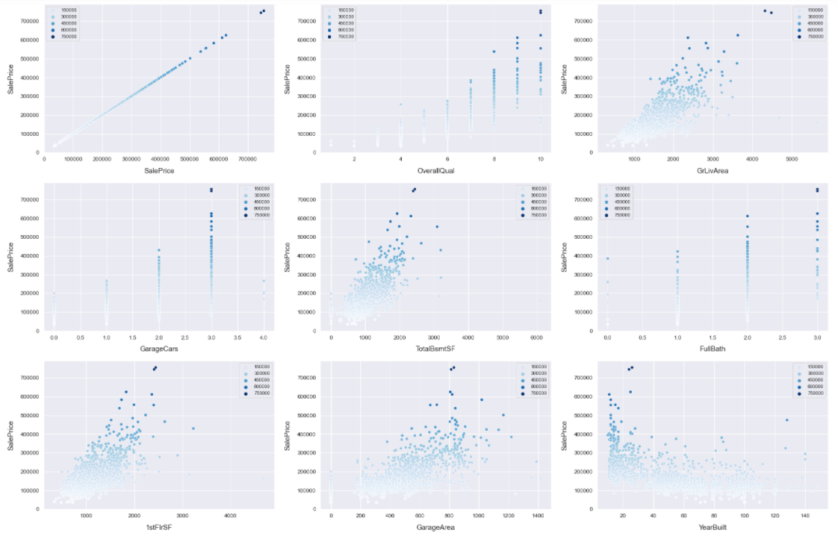
EDA- Target variable Vs. Independent variables
Scatter plot to show the relationship between independent variables and target variables

Slide 12
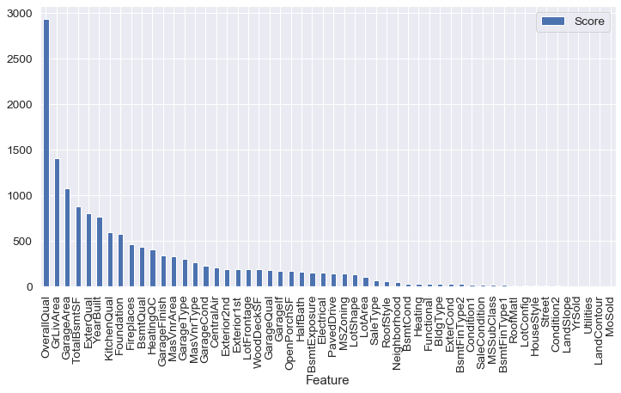
Exploratory Data Analysis Feature Selection: Feature Ranking using KSelect and f-regression Removed features with low ranking selected 41 out of 54
from sklearn.feature_selection import SelectKBest,chi2
from sklearn.feature_selection import f_regression
bestfeatures = SelectKBest(f_regression, k=40)
fit = bestfeatures.fit(X, final_labels)

Slide 13
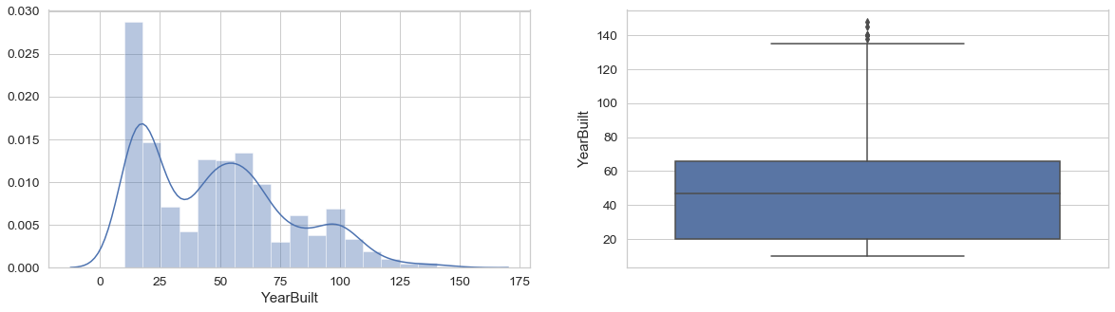
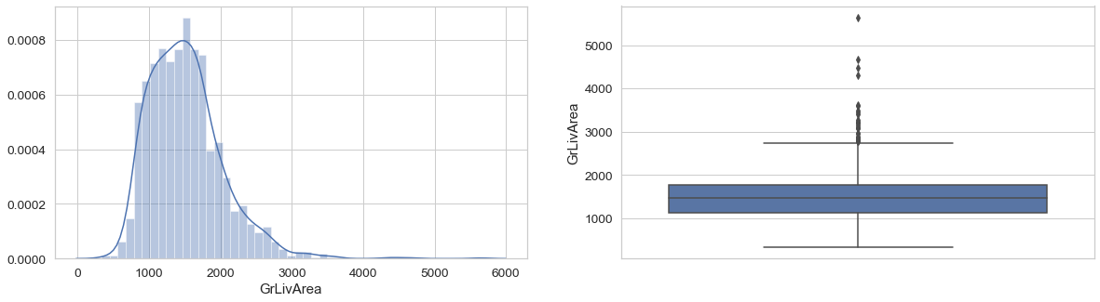
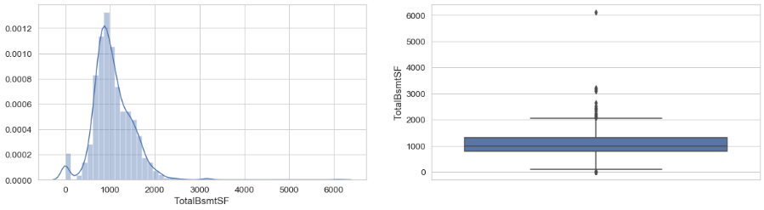
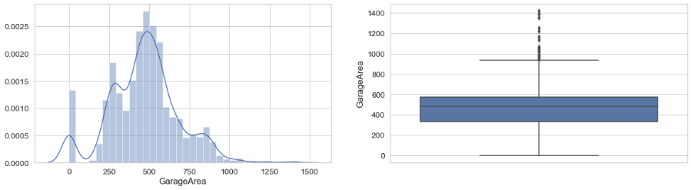
Exploratory Data Analysis Outliers Removal and numerical data scaling
REMOVING ALL OUTLIER VALUES using IQR
X_Out = trainData[~((trainData < (Q1 - 1.5 * IQR)) | (trainData > (Q3 + 1.5 * IQR))).any(axis=1)]
LocaloutlierFactor
Isolation forest

Slide 14
Regression Models-Parametric
Linear Regression - Linear Regression establishes a relationship between dependent variable (Y) and one or more independent variables (X) using a best fit straight line (also known as regression line).
Equation: Y=a+b*X + e. Best fit by reducing sum of squares of error:
Ridge Regression - Ridge Regression is used whenever there is collinearity (strong correlation) amongst the predictor variables. By adding degree of bias to regression estimator reduces standard error
y=a+b*x+e (error term), [error term is the value needed to correct for a prediction error between the observed and predicted value]
Lasso Regression- Similar to Ridge Regression, Lasso (Least Absolute Shrinkage and Selection Operator) also penalizes the absolute size of the regression coefficients.
This leads to penalizing (or equivalently constraining the sum of the absolute values of the estimates) values which causes some of the parameter estimates to turn out exactly zero.
Larger the penalty applied, further the estimates get shrunk towards absolute zero. This results to variable selection out of given n variables
ElasticNet Regression- ElasticNet is hybrid of Lasso and Ridge Regression techniques. It is trained with L1 and L2 prior as regularized. Elastic-net is useful when there are multiple features which are correlated. Lasso is likely to pick one of these at random, while elastic-net is likely to pick both.

Slide 15
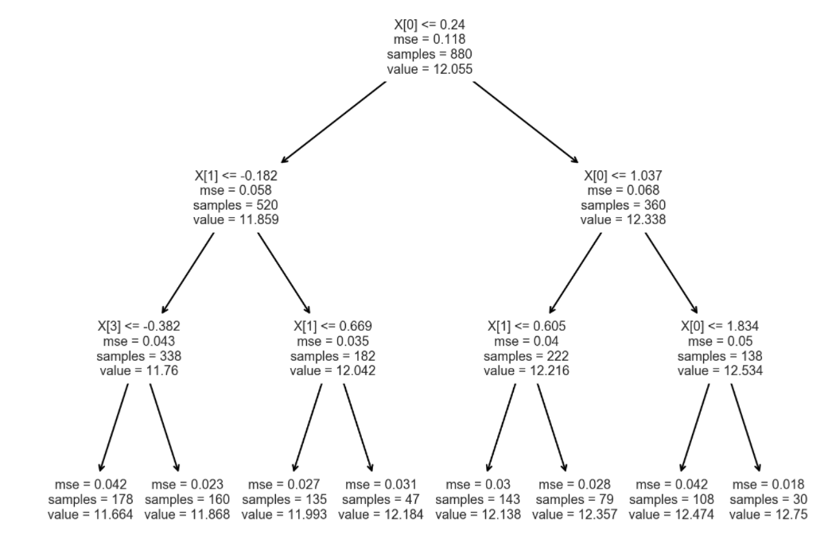
Regression Models-non Parametric
Decision Tree - The decision tree Algorithm belongs to the family of supervised machine learning algorithms. It can be used for both a classification problem as well as for regression problem. The goal of this algorithm is to create a model that predicts the value of a target variable, for which the decision tree uses the tree representation to solve the problem in which the leaf node corresponds to a class label and attributes are represented on the internal node of the tree.

Slide 16
Model Training
Model | Train Accuracy | Test Accuracy | RMSE
Linear Regression | .883 | .887 | .113
Decision Tree | .70 | .65 | .231
Lasso Regression | .875 | .891 | .110
Ridge Regression | .863 | .866 | .123
Elastic Net | .877 | .892 | .110

Slide 17
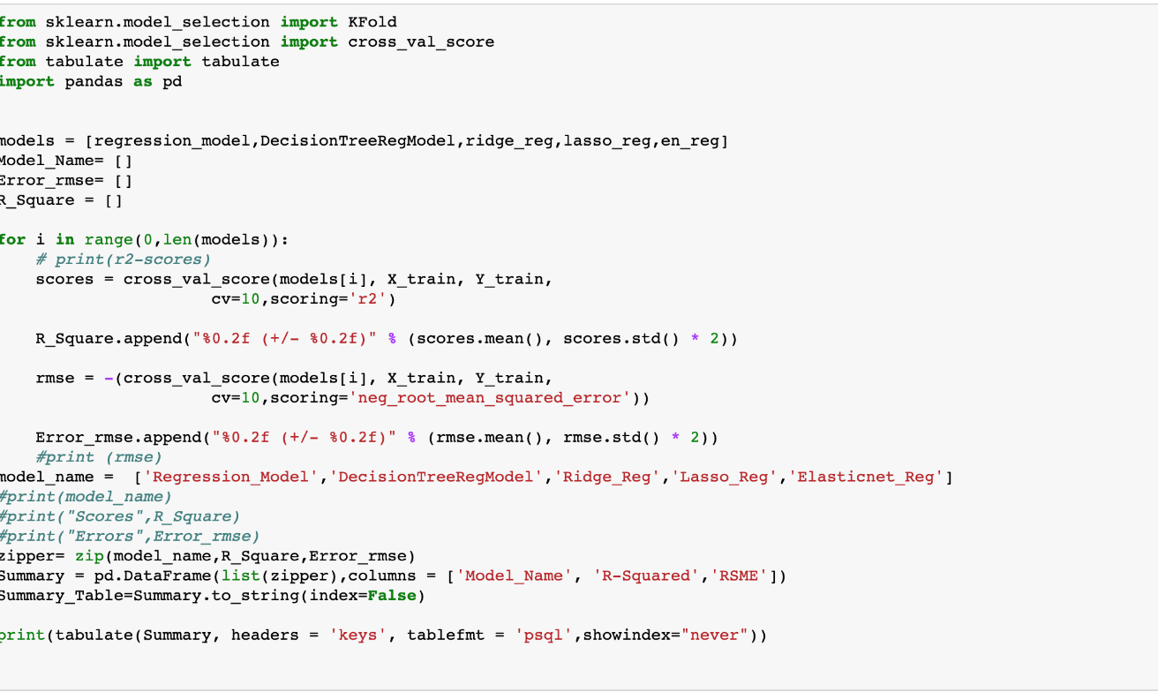
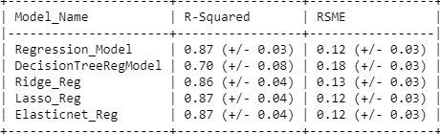
Summarize using k-fold

Slide 18

Validation curve and learning Curve
Learning curve calculated from the training dataset that gives an idea of how well the model is learning.
Underfit
Overfit
Good Fit
Learning curve calculated from a hold-out validation dataset that gives an idea of how well the model is generalizing.

Slide 19
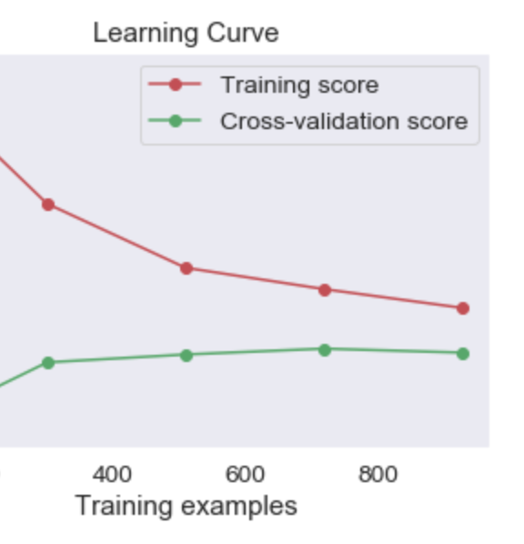
Validation curve and learning Curve
Above example shows the training curve for a classifier where training and validation scores converge to a low value. This classifier would hardly benefit from adding more training data; a more expressive model may be more appropriate.

Slide 20
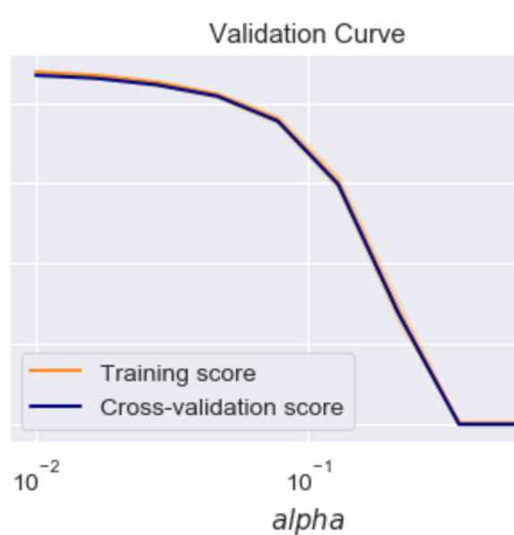
Validation curve and learning Curve
For high-bias models, the performance of the model on the validation set is similar to the performance on the training set.
For high-variance models, the performance of the model on the validation set is far worse than the performance on the training set.
This model shows low bias and low variance

Slide 21
Conclusion
We conclude that the best method for predicting House Prices for this data set is Multivariate Linear Regression.
From the importance function output, we can see that the three top factors that predict Price of the house are:
OverallQual: Rates the overall material and finish of the house
GrLivArea: Above grade (ground) living area square feet
GarageArea: Size of garage in square feet

Slide 22
Q&A

Slide 23

Thank You

